Slide 1

Ad-Sposure Predicting Advertising Truck Exposure
Massy Farkhondeh

Slide 2


Hauler Ads
Provide billboards on delivery trucks
Wireless device
Unique identifier

Slide 3
Objective
Predict the number of people exposed to advertising trucks in Ontario

Slide 4
Objective
Predict the number of people exposed to advertising trucks in Ontario
Enhance ads. campaign

Slide 5
Objective
Predict the number of people exposed to advertising trucks in Ontario
Enhance ads. campaign
Sell more ads. space
Revenue

Slide 6
Data
Data points ≈ 3M
Delivery schedule and timelines not provided
Time | Lat. | Lon. | Truck# | Unique address | City | Weekday | Speed [km/h]
2019-04-20 13:18:31 | 43.6594 | -79.6872 | 59 | d4:e6:b7:db:94:5b | Brampton | Saturday | 90

Slide 7
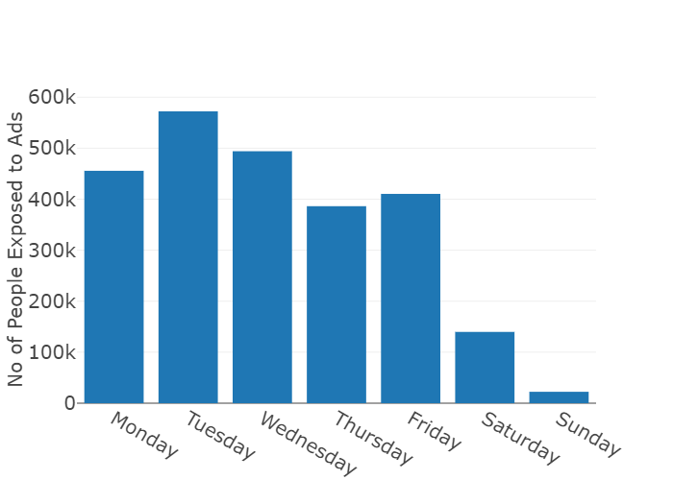
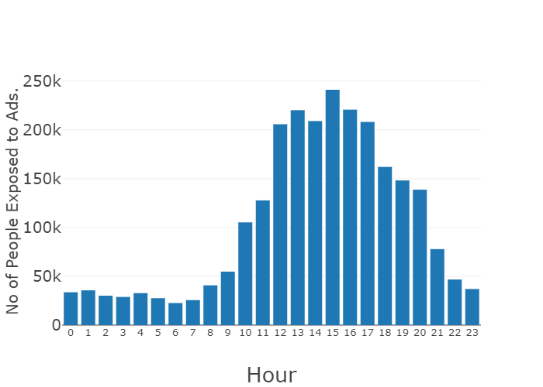
Hourly Exposure
Overall Ads Exposure in Ontario
Week Day Exposure

Slide 8
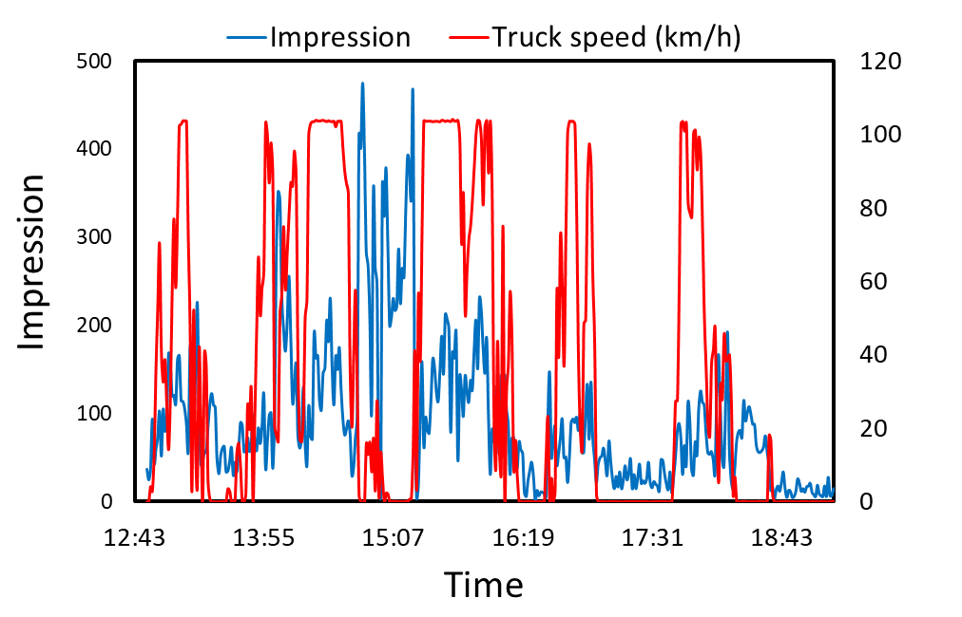
Exposure [29/4/2019]
Exposure
Exposure
Speed (Km/h)
Notes:
Traffic has high impact on exposure, higher traffic,, lower speed, higher exposure

Slide 9

Pipeline
$$X$$
City
Day of Week
Time
Truck speed

Slide 10

Pipeline
$$X$$
$$Y$$
City
Day of Week
Impression/h
A, B, C, D, E, F
Time
Class Imbalance
Oversampling
Truck speed

Slide 11
Pipeline
$$X$$
One-Hot Encoding
$$Y$$
City
Day of Week
Impression/h
A, B, C, D, E, F
Time
Class Imbalance
Oversampling
Truck speed

Slide 12
Pipeline
$$X$$
One-Hot Encoding
Train
Test Validation
$$Y$$
City
Day of Week
Impression/h
A, B, C, D, E, F
Time
Class Imbalance
Oversampling
Truck speed

Slide 13
Random Forest Classification
Train, test & validation
Model accuracy:
87 %
Important features
Truck speed
Time of day
Notes:
Train test and validation, misbalance classes logistic regression
This kind speed what impression and also time
Time of day and truck speed
Trade off with delivery.

Slide 14
Recommendation
Optimizing routes
Number of trucks
Weekend
Time of exposure

Slide 15
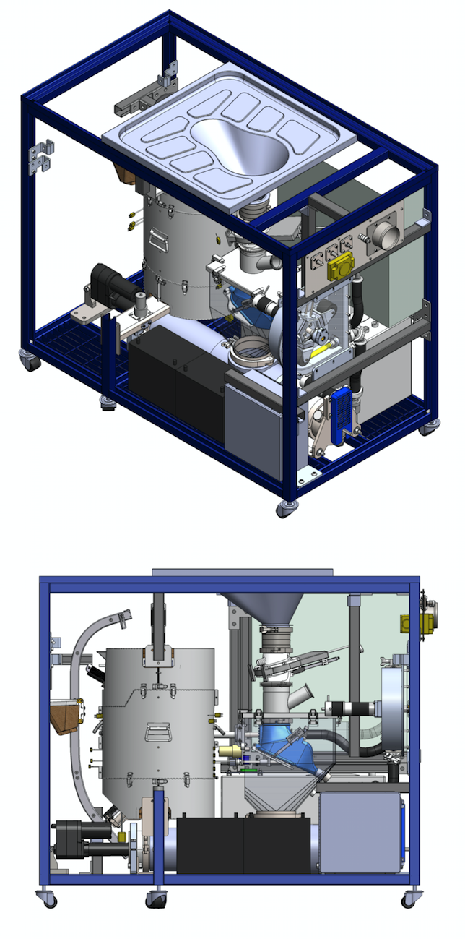




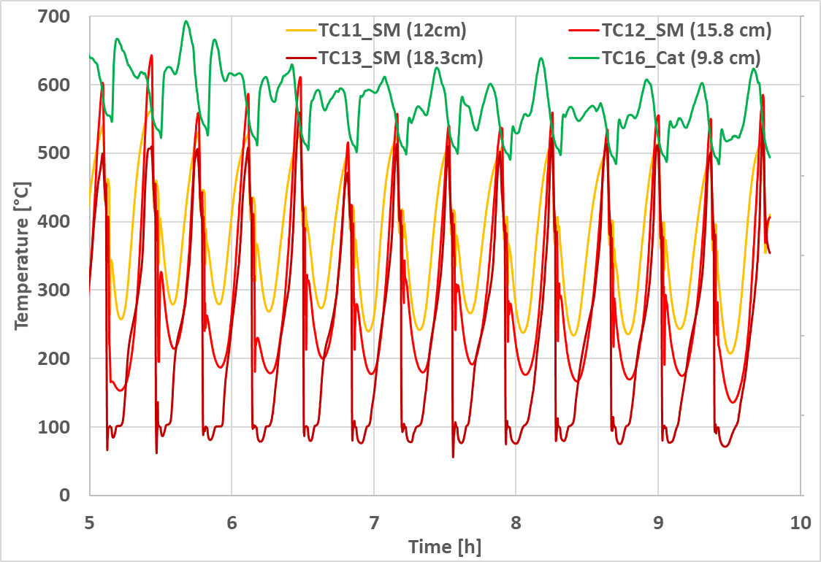

SANITATION
Massy Farkhondeh
PhD CHEMICAL ENGINEERING
MELINDA & BILL GATES FOUNDATION

Slide 16
APPENDIX

Slide 17
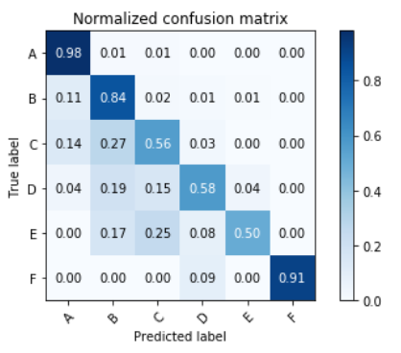
Random Forest Classification
LOW EXPOSURE
HIGH EXPOSURE

Slide 18
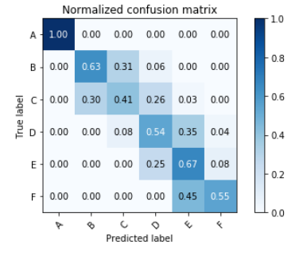
Logistic Regression
LOW EXPOSURE
HIGH EXPOSURE

Slide 19
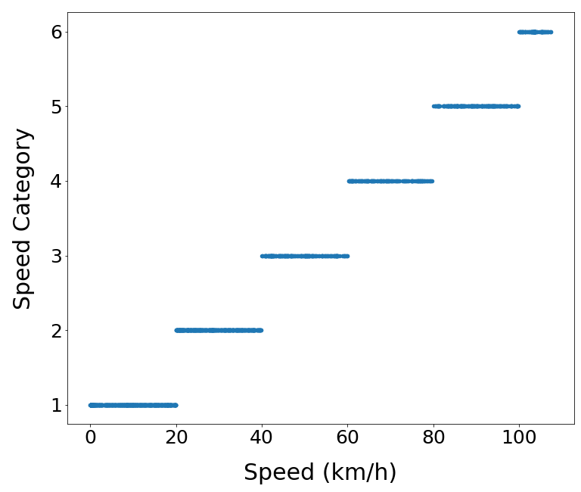
Data Preprocessing/Feature Engineering
Truck Speed Category

Slide 20
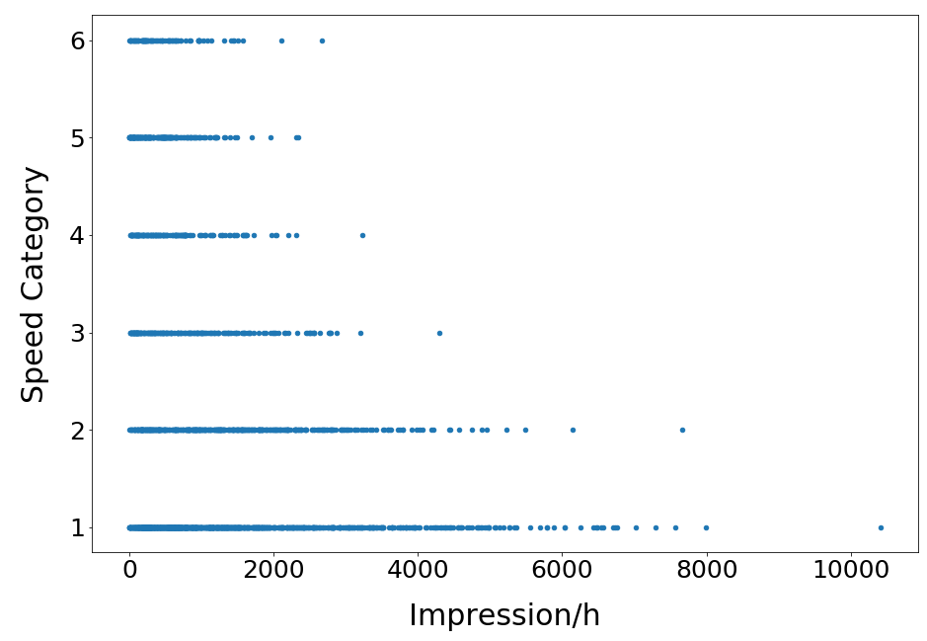
Exposure
Data Preprocessing/Feature Engineering
Truck Speed Category
HIGH SPEED
SLOW SPEED

Slide 21
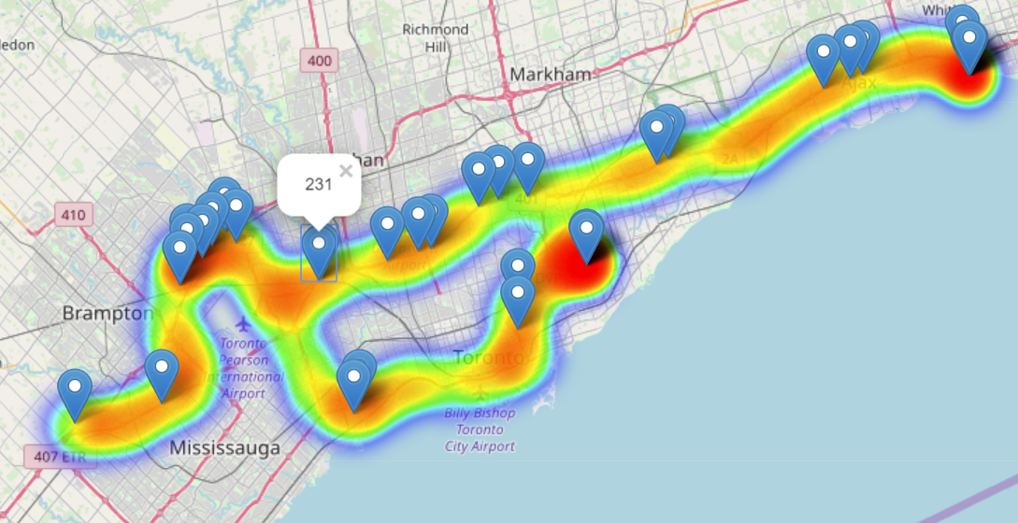
Interactive Heat Map

Slide 22
Classes
Category | Impression /h
A | 0 – 1.3k
B | 1.3k – 2.67k
C | 2.67k – 4k
D | 4k – 5.33k
E | 5.33k – 6.67k
F | 6.67k – 8k

Slide 23
Costing
Highway billboard
400k impressions
in a month
Costs $2000/month
Country road billboard
30k impressions
in a month
Costs $600/month

Slide 24
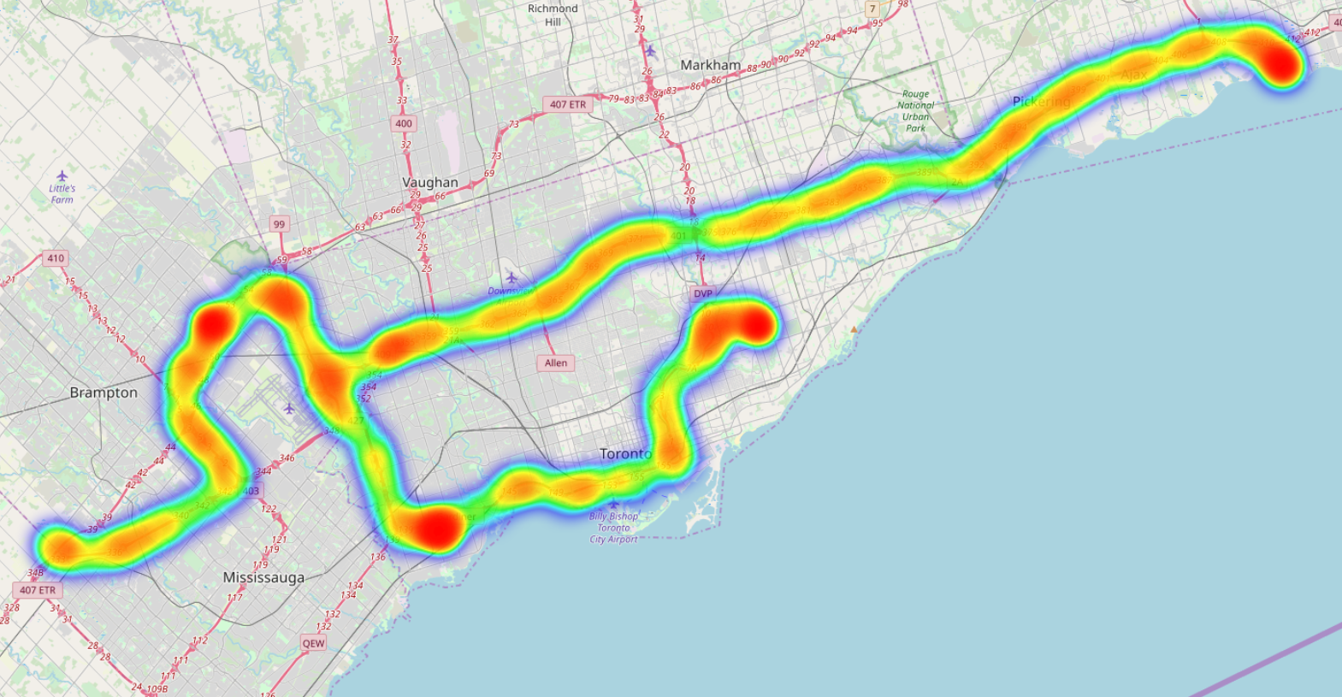
Truck Route [29/04/2019]

Slide 25
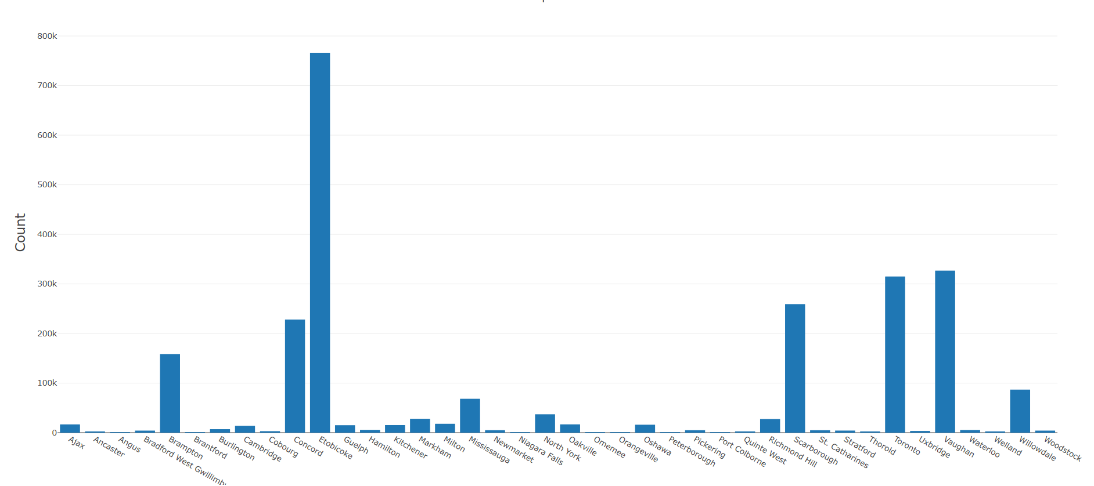
City Impression

Slide 26
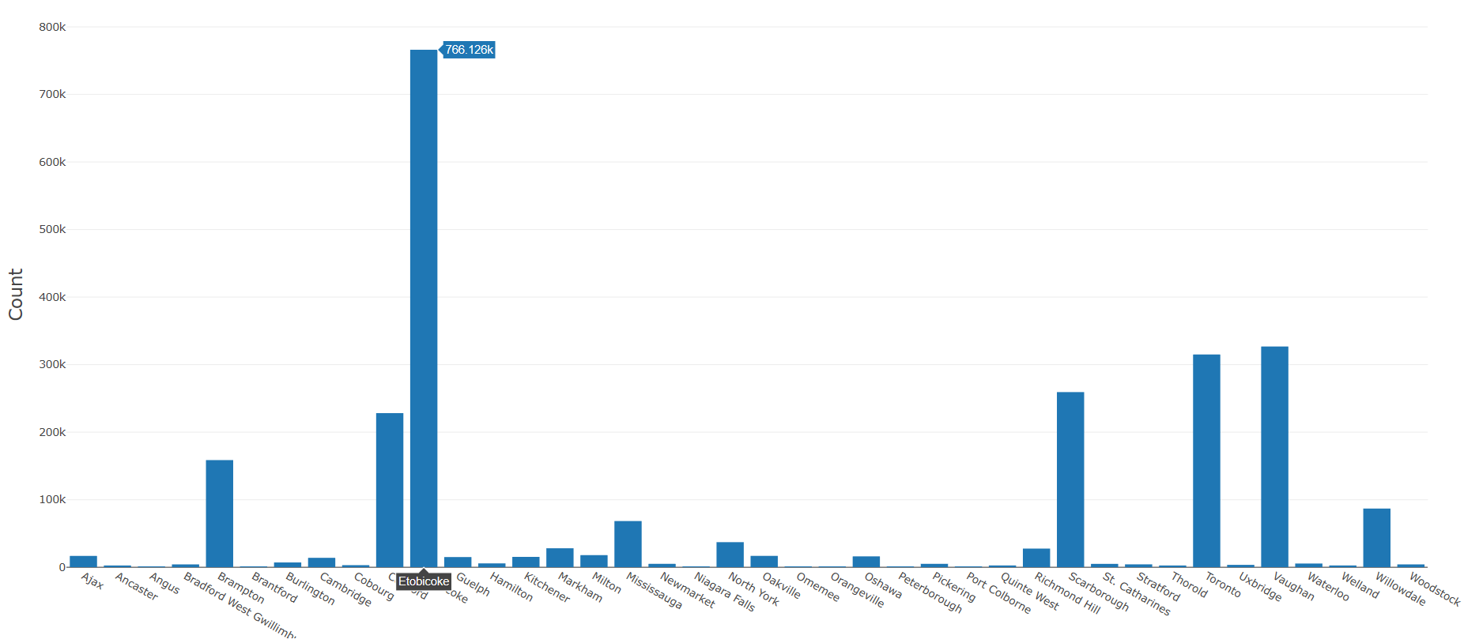
City Impression

